Slide 1
Object Detection Problem
Study Oriented Project

Slide 2
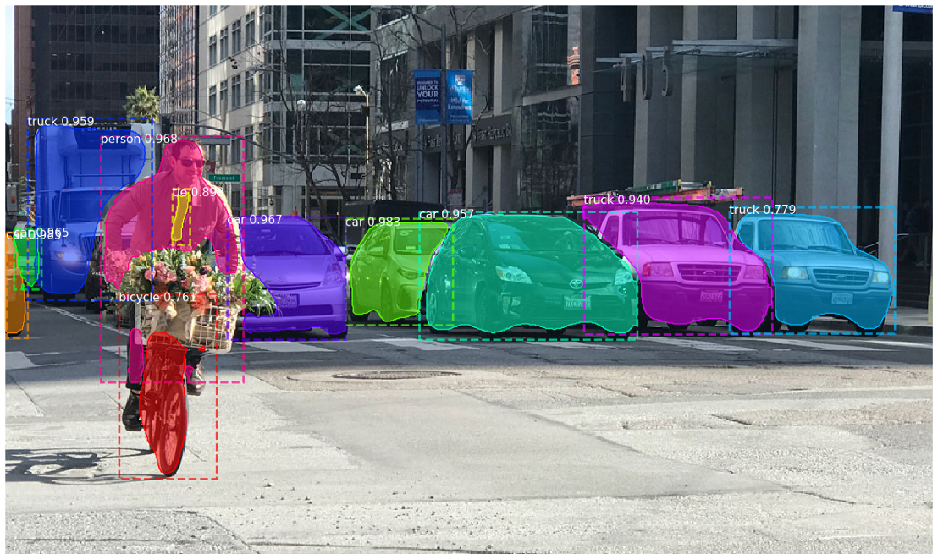

Slide 3
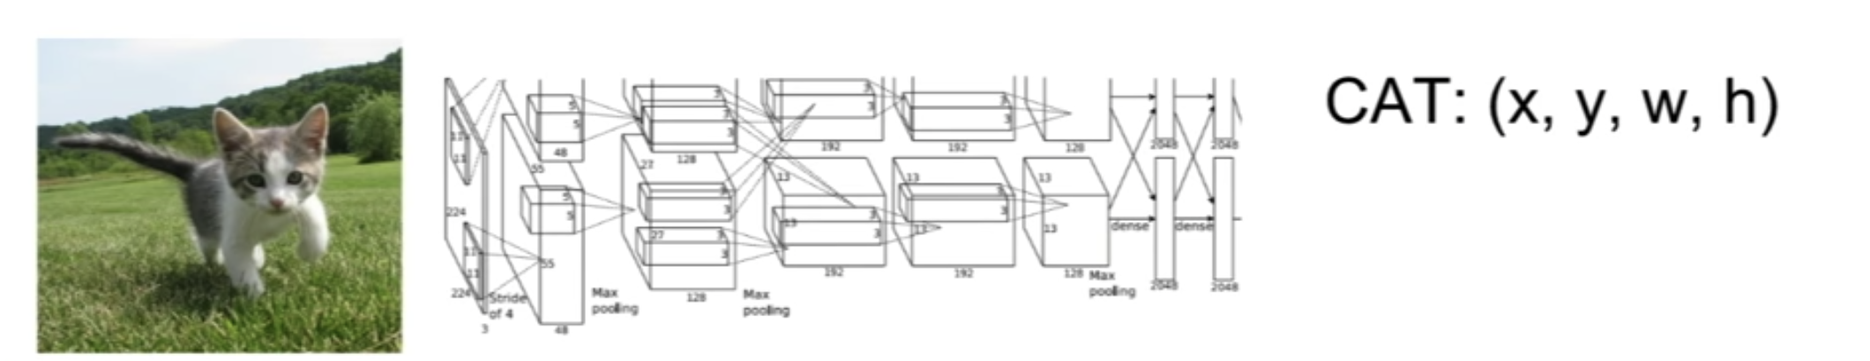
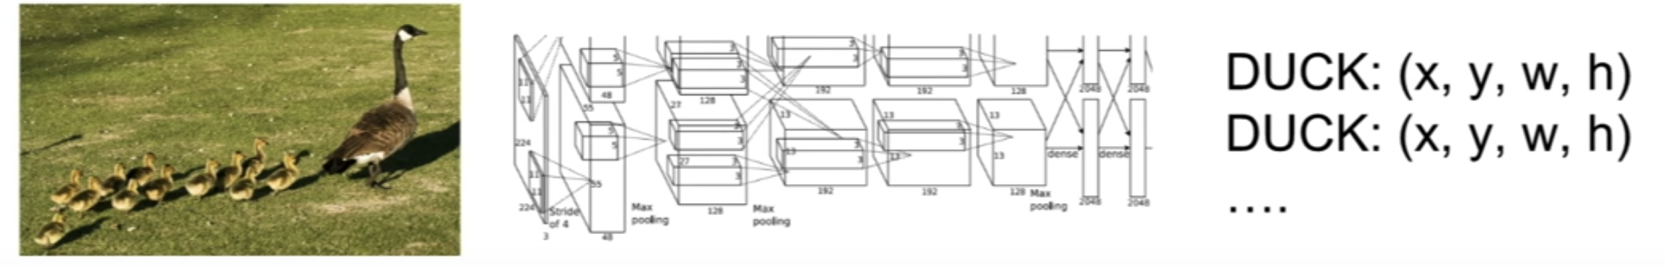
The major reason why you cannot proceed with this problem by building a standard convolutional network followed by a fully connected layer is that, the length of the output layer is variable

Slide 4
Object Detection Techniques
Study Oriented Project

Slide 5

Sliding Window Detectors
One brute force approach for object detection is to slide windows from left and right, and from up to down to identify objects using classification.
we use windows of varied sizes and aspect ratios

Slide 6
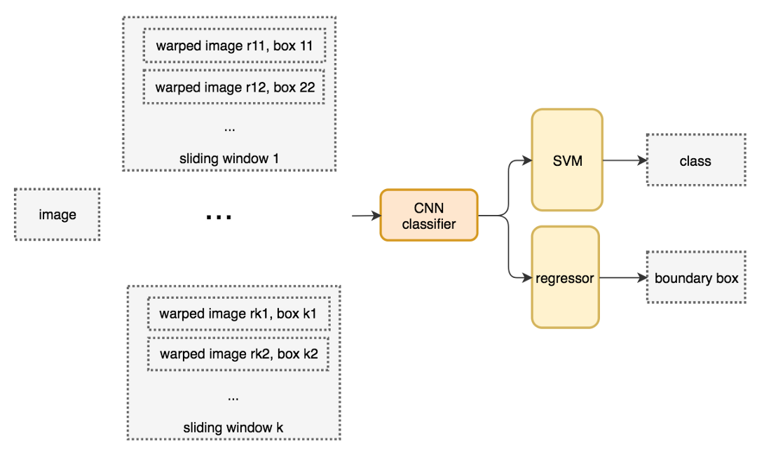

Slide 7
Selective Search Algorithm
To improve performance, one obvious solution is to reduce the number of windows. Thus, instead of a brute force approach, we use a region proposal method to create regions of interest (ROIs) for object detection.
Algorithm
start with each individual pixel as its own group
calculate the texture for each group and combine two that are the closest. Prefer grouping smaller group first.
continue merging regions until everything is combined together.

Slide 8
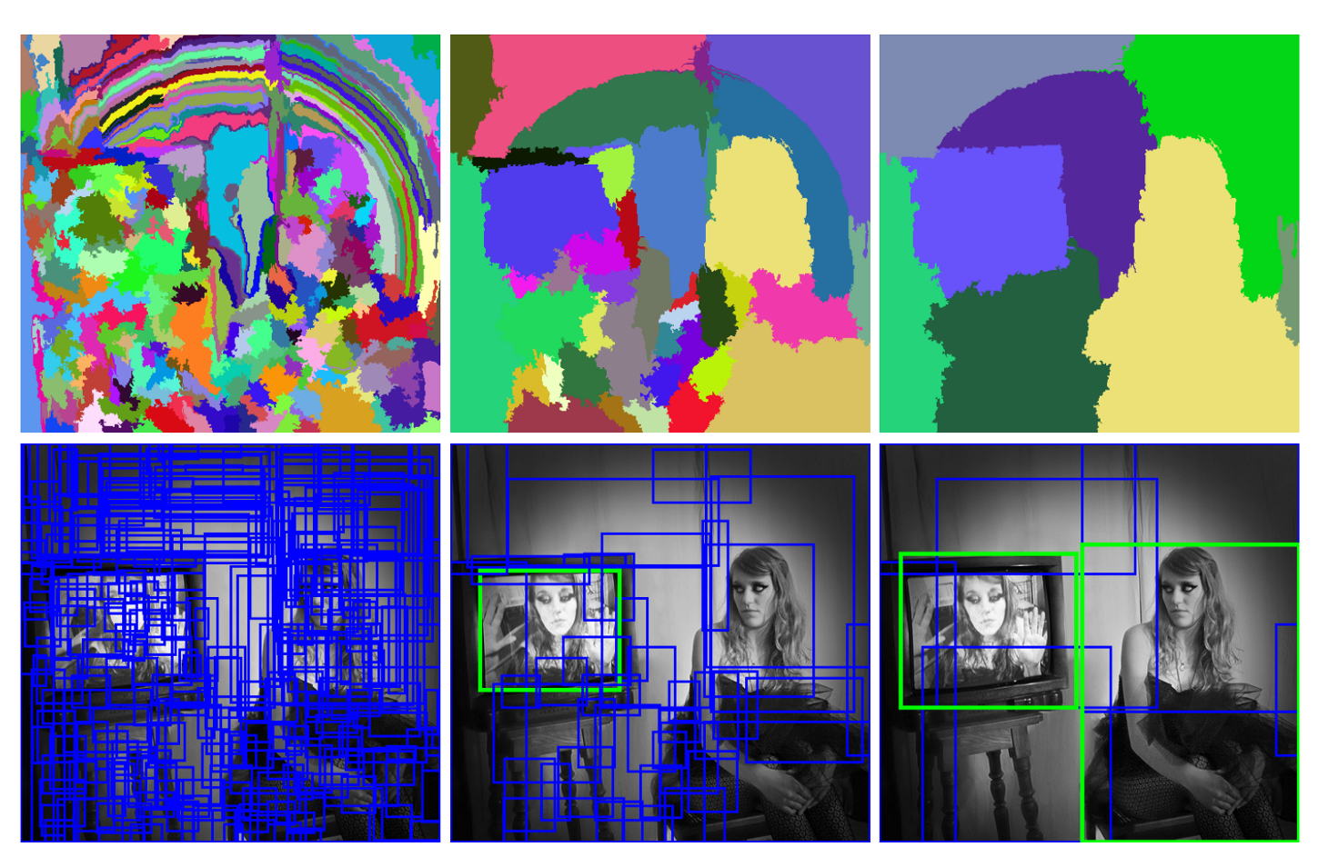

Slide 9
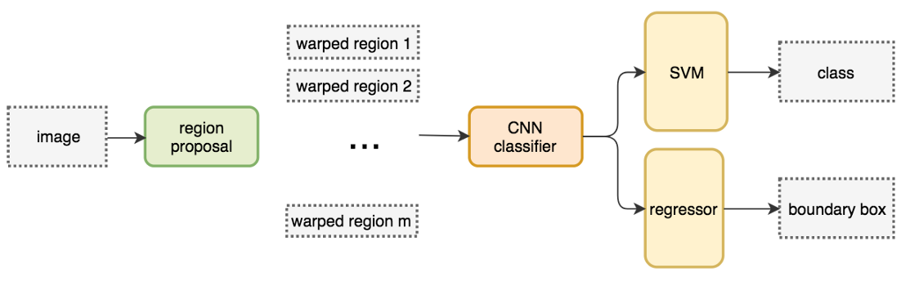
R-CNN
R-CNN makes use of a region proposal method to create about 2000 ROIs
The regions are warped into fixed size images and feed into a CNN network individually.
It is then followed by fully connected layers to classify the object and to refine the boundary box.

Slide 10
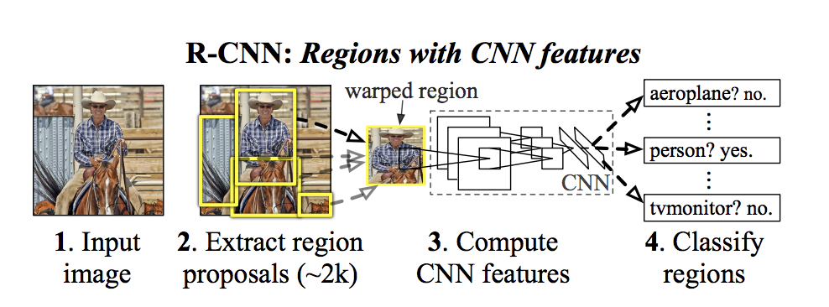

Slide 11
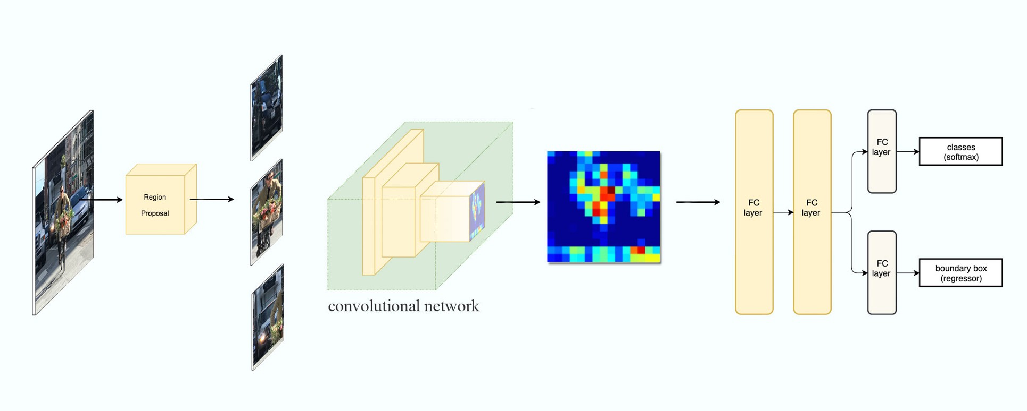
With far fewer but higher quality ROIs, R-CNN run faster and more accurate than the sliding windows.

Slide 12
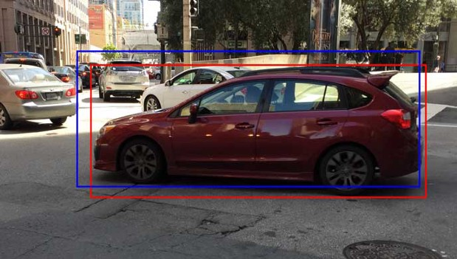
Why boundary box regressor?
Because region proposal methods are computation intense. To speed up the process, we often pick a less expensive region proposal method to create ROIs followed by a linear regressor (using fully connected layers) to refine the boundary box further.

Slide 13
Problems with R-CNN
R-CNN is slow in training & inference
If we have 2,000 proposals, each of them is processed by a CNN separately, i.e. we repeat feature extractions 2,000 times for different ROIs.
Solution : Fast R- CNNs
Instead of extracting features for each image patch from scratch, we use a feature extractor (a CNN) to extract features for the whole image first.
We warp the patches to a fixed size using ROI pooling and feed them to fully connected layers for classification and localization

Slide 14
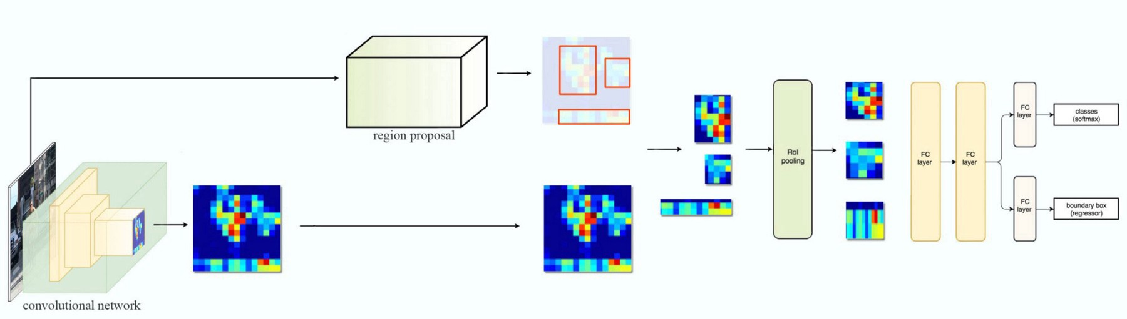

Slide 15
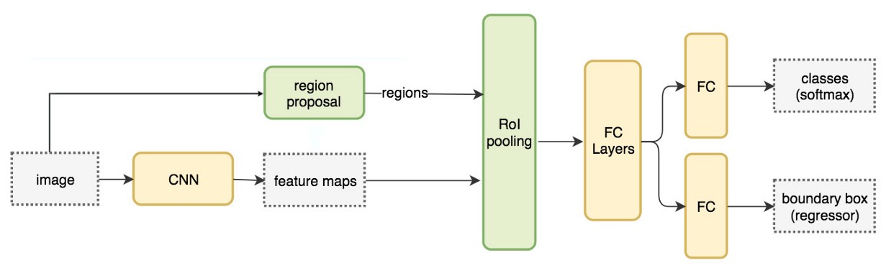
Fast R-CNN is 10x faster than R-CNN in training and 150x faster in inferencing.

Slide 16
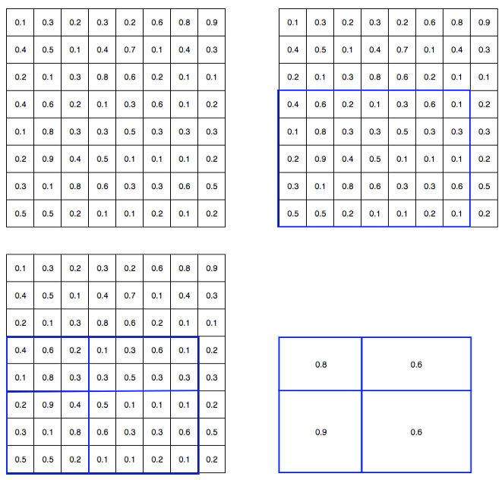
About RoI pooling
We apply ROI pooling to warp the variable size ROIs into in a predefined size shape. Let’s simplify the discussion by transforming 8 × 8 feature maps into a predefined 2 × 2 shape.
Top left: our feature maps.
Top right: we overlap the ROI (blue) with the feature maps.
Bottom left: we split ROIs into the target dimension. For example, with our 2×2 target, we split the ROIs into 4 sections with similar or equal sizes.
Bottom right: find the maximum for each section and the result is our warped feature maps.

Slide 17
Faster R-CNN
Base Paper

Slide 18
Fast R-CNN depends on an external region proposal method like selective search. However, those algorithms run on CPU and they are slow. In testing, Fast R-CNN takes 2.3 seconds to make a prediction in which 2 seconds are for generating 2000 ROIs.
Faster R-CNN adopts similar design as the Fast R-CNN except it replaces the region proposal method by an internal deep network and the ROIs are derived from the feature maps instead. The new region proposal network (RPN) is more efficient and run at 10 ms per image in generating ROIs.

Slide 19
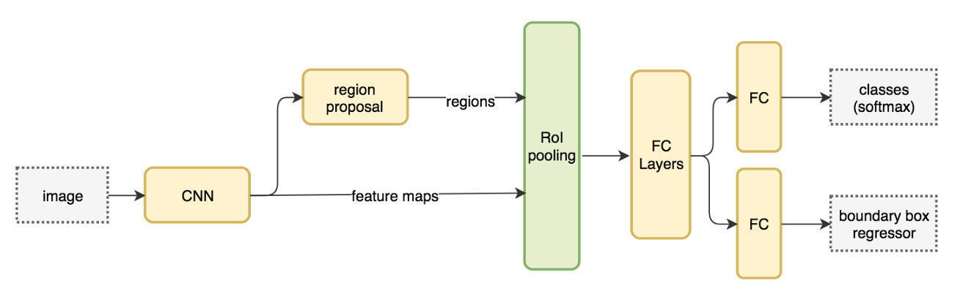

Slide 20

The network flow is similar but the region proposal is now replaced by a convolutional network (RPN).

Slide 21
Region Proposal Network
The region proposal network (RPN) takes the output feature maps from the first convolutional network as input. It slides 3 × 3 filters over the feature maps to make class-agnostic region proposals using a convolutional network like ZF network. Other deep network likes VGG or ResNet can be used for more comprehensive feature extraction at the cost of speed. The ZF network outputs 256 values, which is feed into 2 separate fully connected layers to predict a boundary box and 2 objectness scores. The objectness measures whether the box contains an object. We can use a regressor to compute a single objectness score but for simplicity, Faster R-CNN uses a classifier with 2 possible classes: one for the “have an object” category and one without (i.e. the background class).

Slide 22
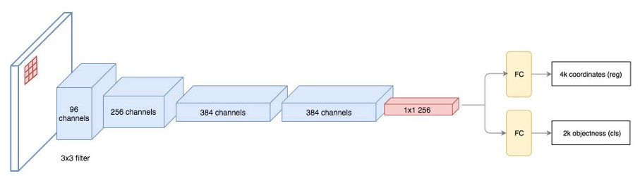

Slide 23
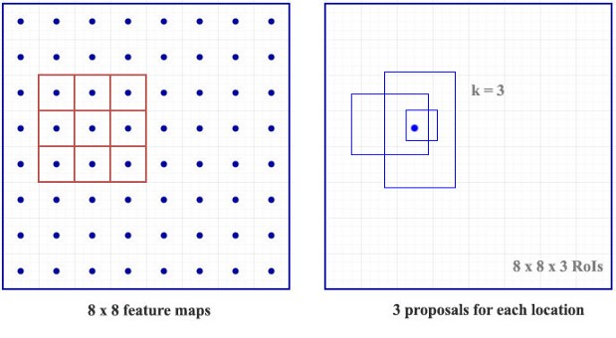
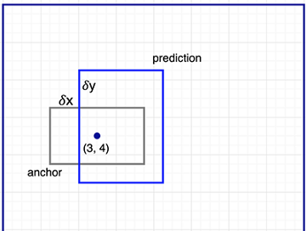
For each location in the feature maps, RPN makes k guesses. Therefore RPN outputs 4×k coordinates and 2×k scores per location. The diagram below shows the 8 × 8 feature maps with a 3× 3 filter, and it outputs a total of 8 × 8 × 3 ROIs (for k = 3). The right side diagram demonstrates the 3 proposals made by a single location.
Faster R-CNN does not make random boundary box proposals. Instead, it predicts offsets like 𝛿x, 𝛿y that are relative to the top left corner of some reference boxes called anchors. We constraints the value of those offsets so our guesses still resemble the anchors

Slide 24
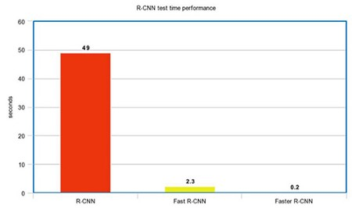
Performance of Faster R-CNN

Slide 25
My Pipeline (Phase - 1)
Object detection (done)
Region Proposals (done)
R-CNN, Fast R-CNN (done)
Faster R-CNN (Read Base Paper) (done)
Get Familiar with PASCAL VOC
Read about VGG network (done)
Implement Paper
Documentation of code
Github
Plan to complete by 28 Jan 2020

